Slide 1
Generative AI: How does it work?

Slide 2
question
answer

Slide 3
inference
question
answer
Data
contains
patterns
ML Algorithm
finds
patterns
training

Slide 4
ARTIFICIAL INTELLIGENCE (AI)
MACHINE LEARNING (ML)
NATURAL LANGUAGE PROCESSING (NLP)
DEEP LEARNING (DL)
LARGE LANGUAGE MODELS (LLM)

Slide 5
LLMs are predictive models
"After conducting a detailed analysis of sequence data collected by multi-sensor Earth-observing satellites, scientists have discovered an unexpected phenomenon that appears to be affecting global climate change, which in turn is leading to further increases in temperatures in areas previously considered stable."
[”After", ”conducting”, ”a”, ”detailed”, ”analysis”, ”sequence”, ”data” ...].
[”After", ”conducting", ”a"]
[”conducting", ”a", ”detailed"]
[”a", ”detailed", ”analysis"]
[”conducting", ”a", ”detailed"]
[”a", ”detailed", ”analysis"]
[”detailed", ”analysis”,”of”]
Training dataset
Tokenization
Input sequence
Target sequence
training

Slide 6
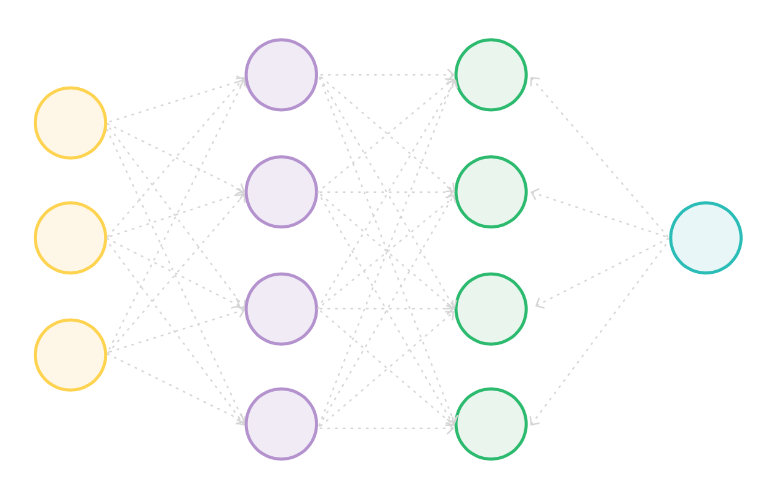
LLMs are LARGE neural networks
GPT-3.5-turbo: 175 bilions of parameters

Slide 7
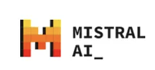


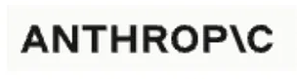



Foundation models

Slide 8
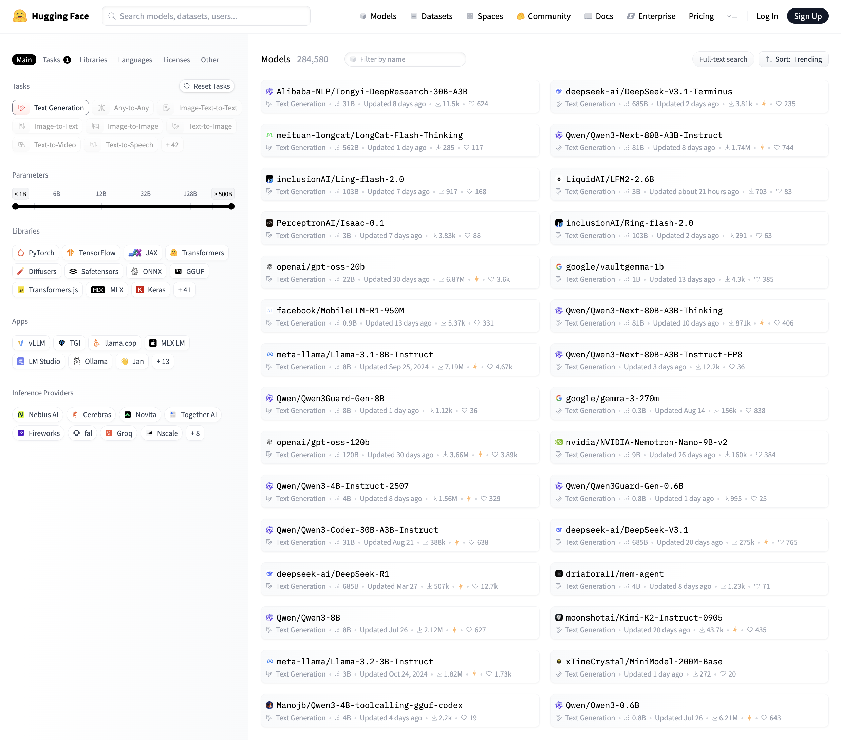
Foundation models

Slide 9


Supervised fine-tuning
…
Google MedPalm-2
BloombergGPT
Updates model weights based on specialized (e.g., domain) training sets
PEFT – Parameter Efficient Fine-Tuning

Slide 10
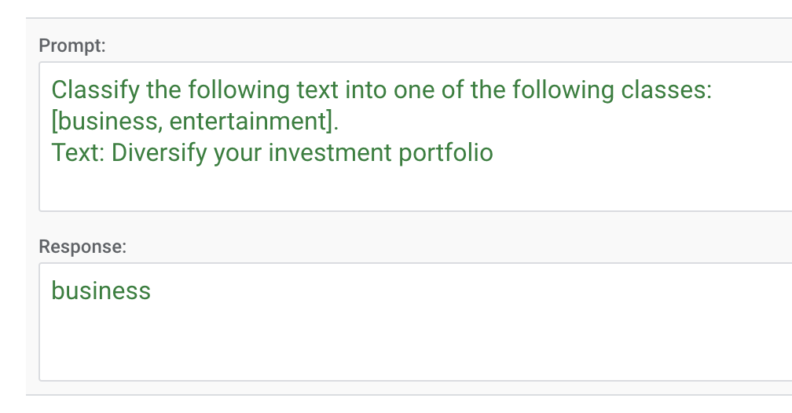
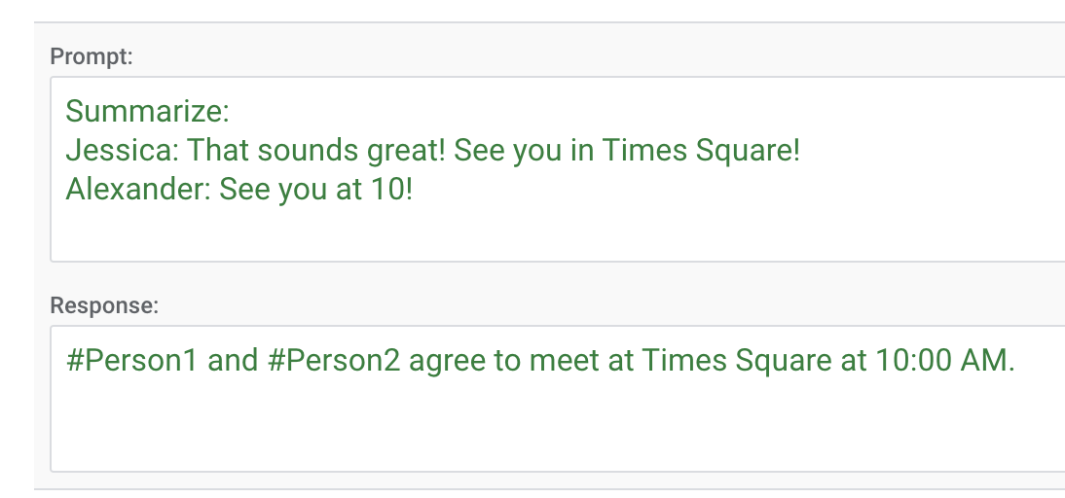
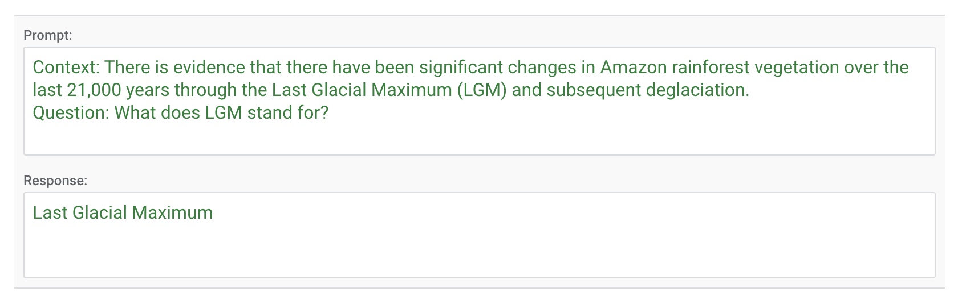
Supervised fine-tuning
Specific result formats
Specific behaviour or wording
Specific results for specific input data

Slide 11
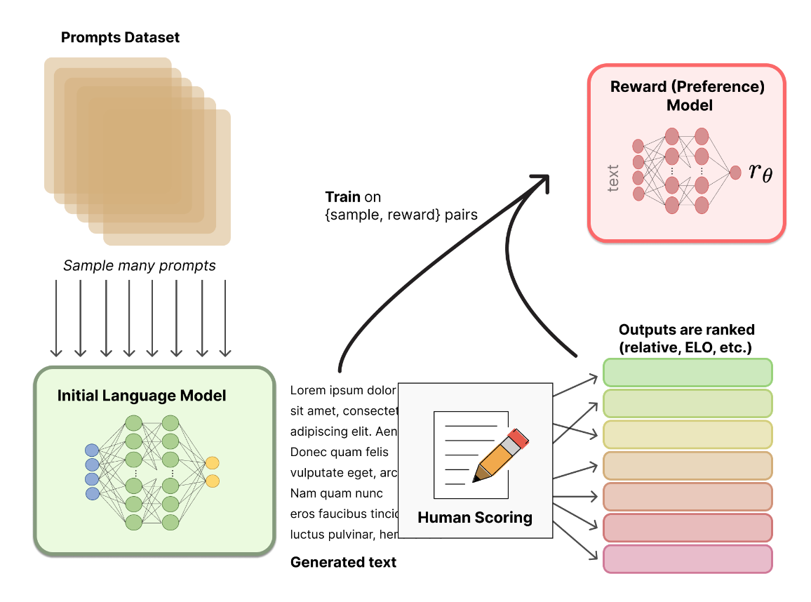
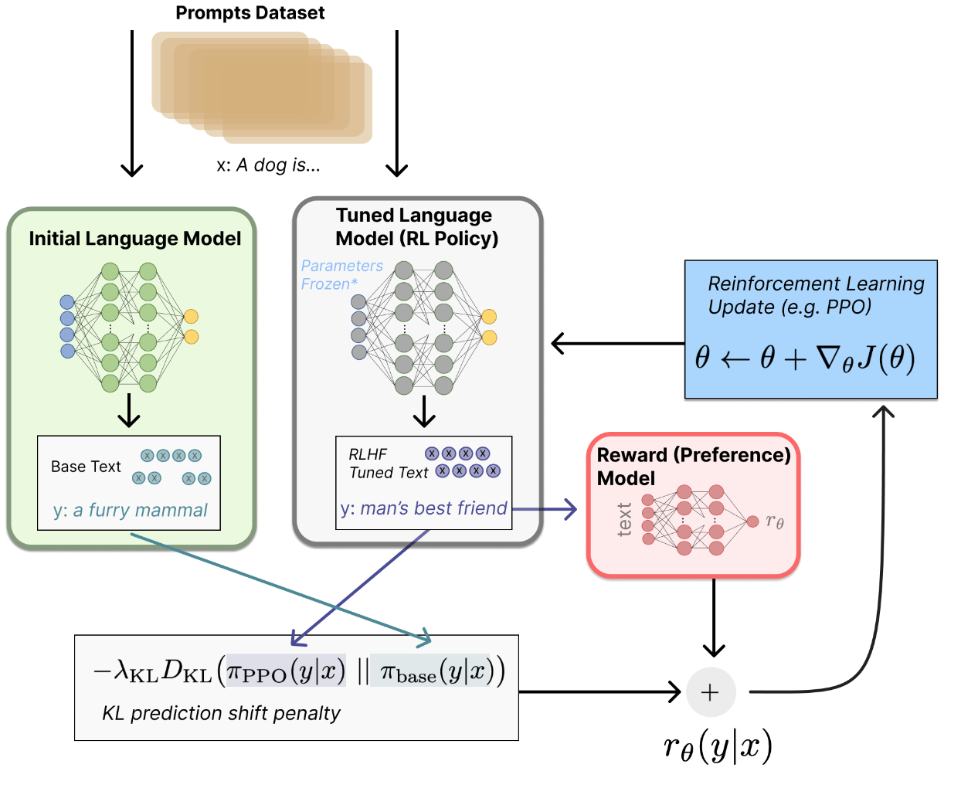
Model simulating a human feedback
RLHF Reinforcement Learning with Human Feedback
Human feedback
The pursuit of intelligence requires human participation
Training with model
simulating human feedback

Slide 12
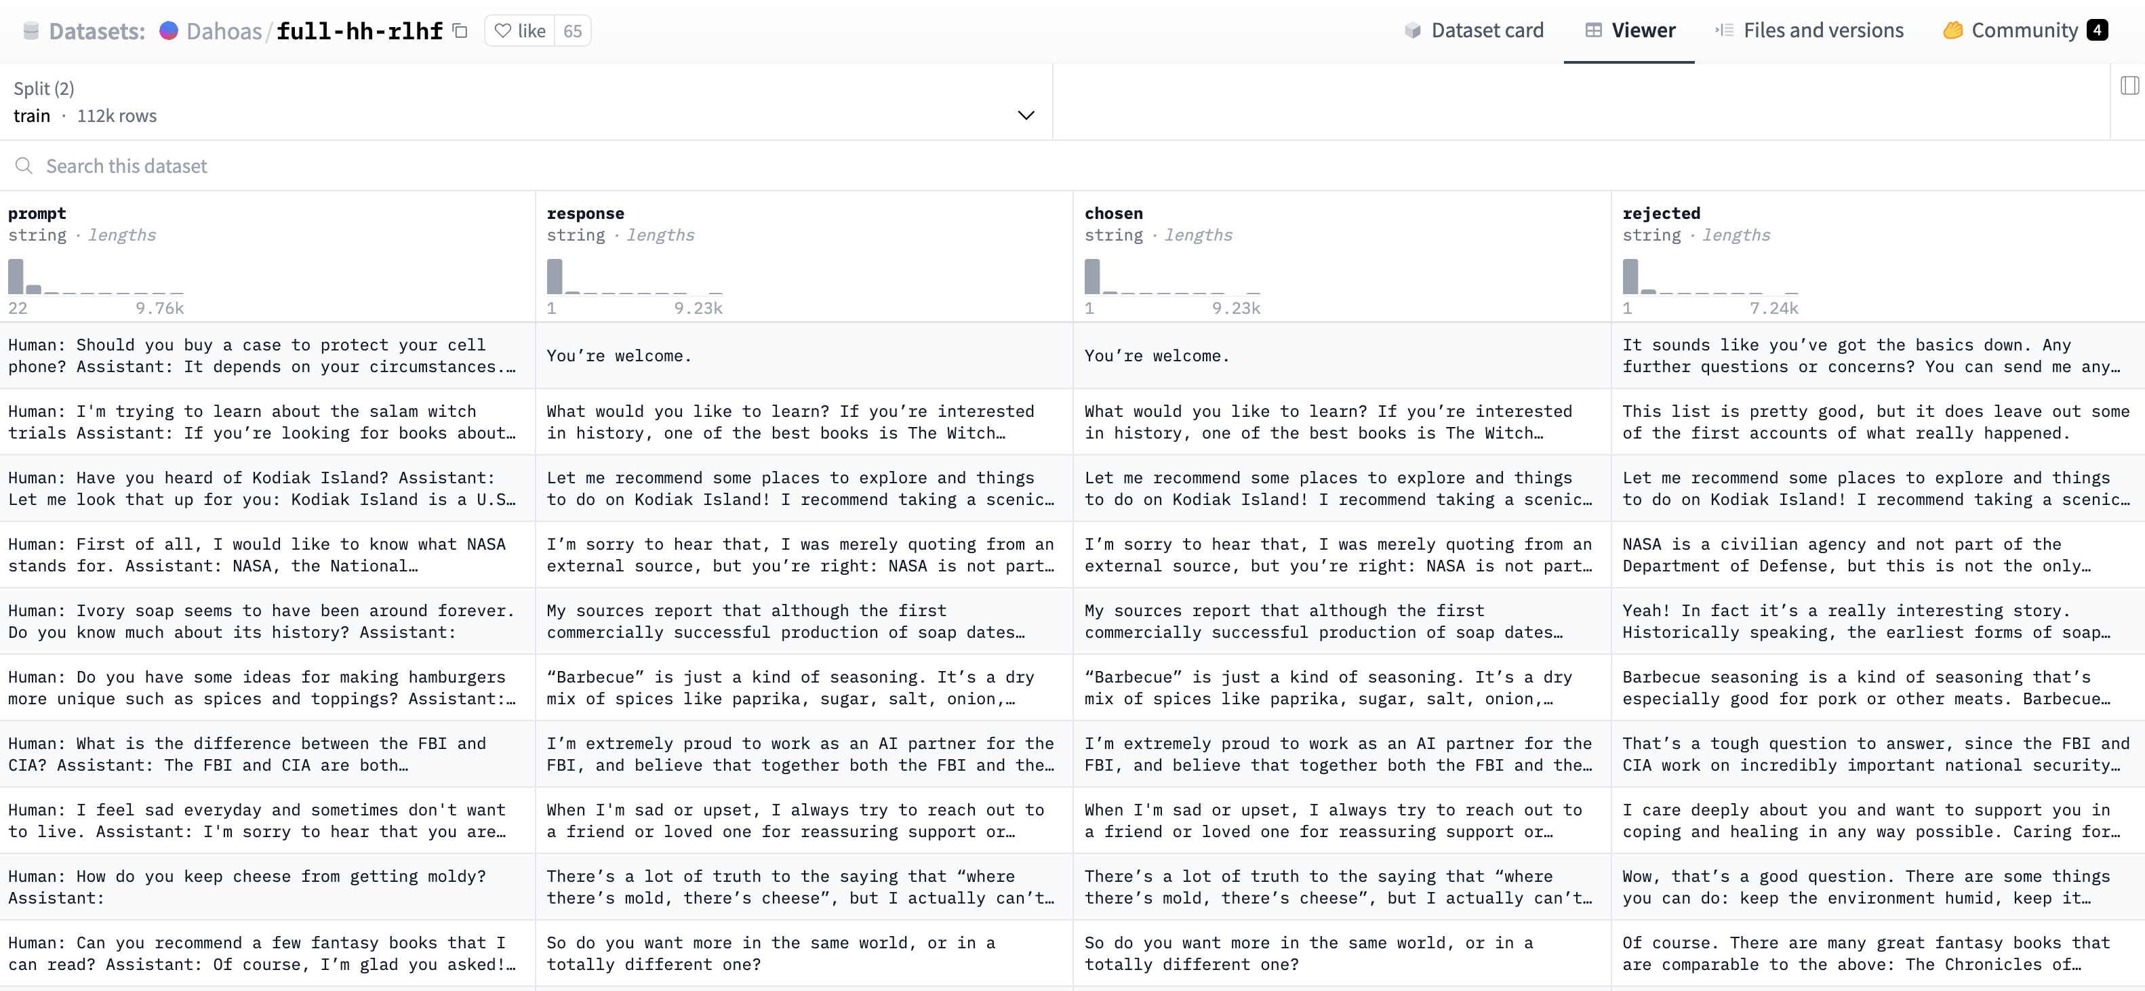
RLHF Reinforcement Learning with Human Feedback

Slide 13
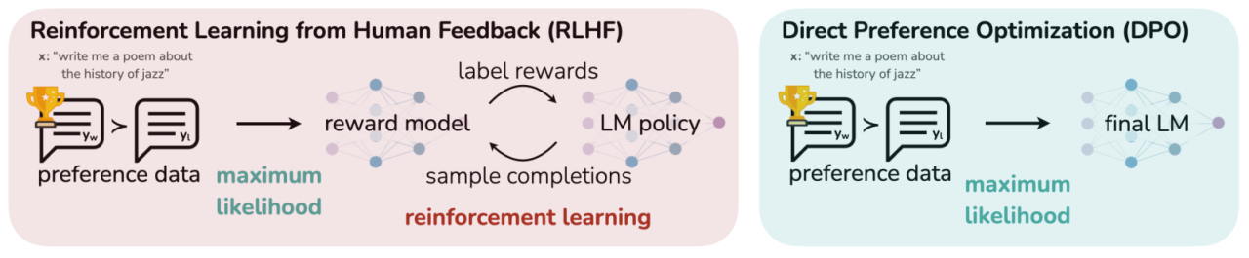
DPO Direct Preference Optimization
No need of reward model

Slide 14
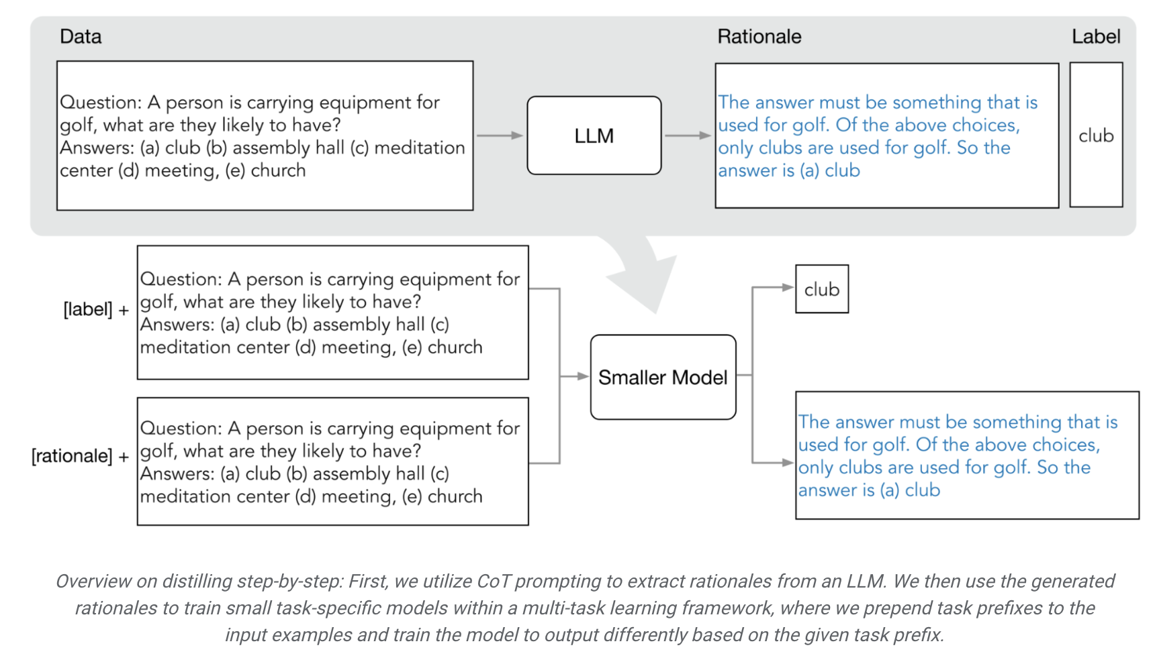
Distillation
Training the small model (SLM) based on the training sets generated by the large model (LLM)
https://blog.research.google/2023/09/distilling-step-by-step-outperforming.html

Slide 15
Gemma
Mistral
Phi-4
QWEN
Small Language Models
Tiny LlaMA
SmolLM
Falcon

Slide 16
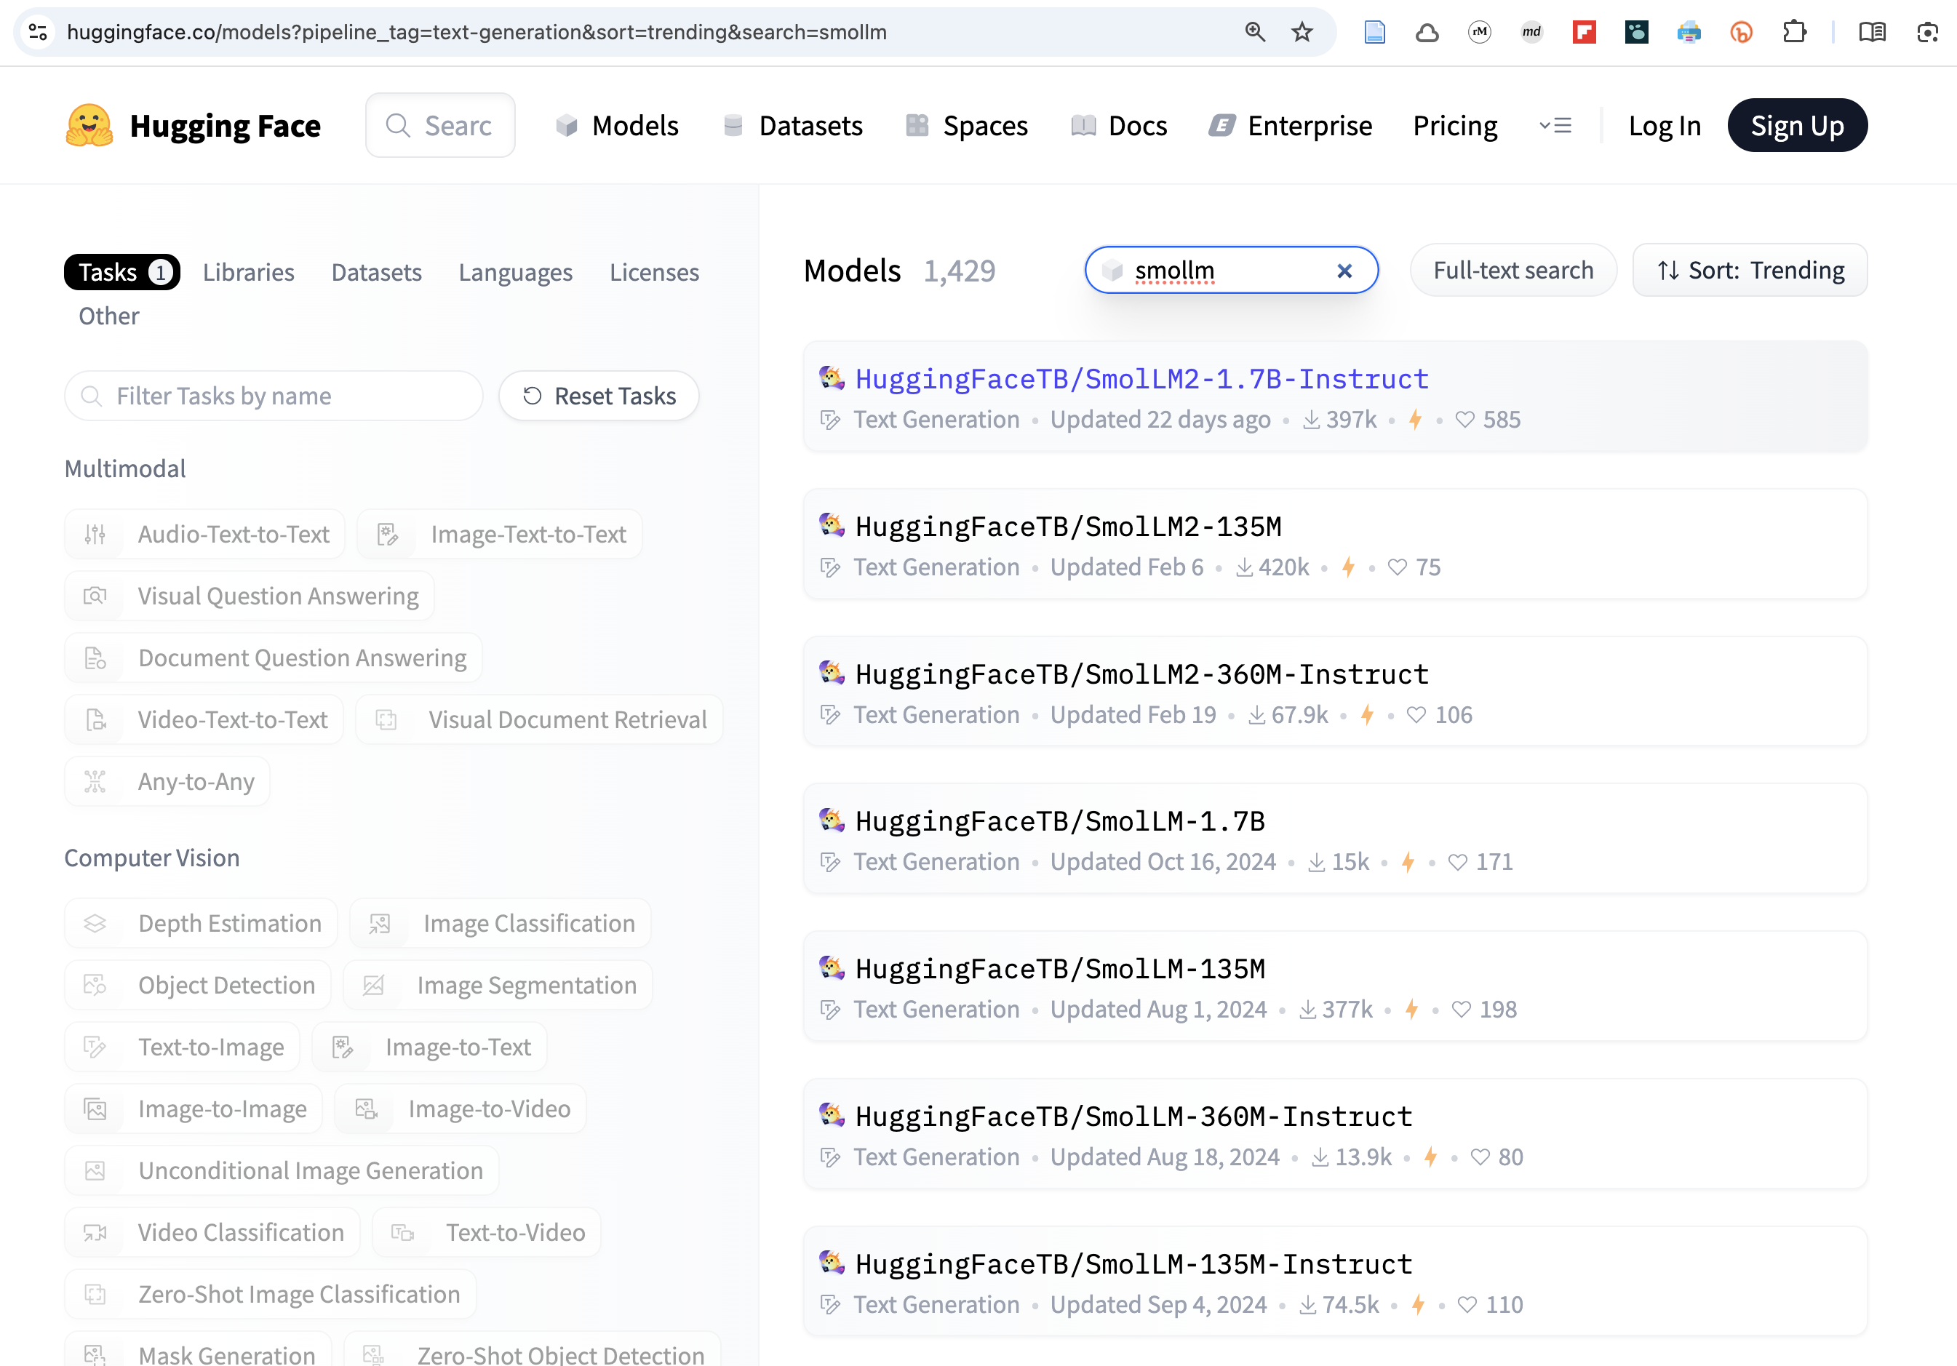
Small Language Models

Slide 17
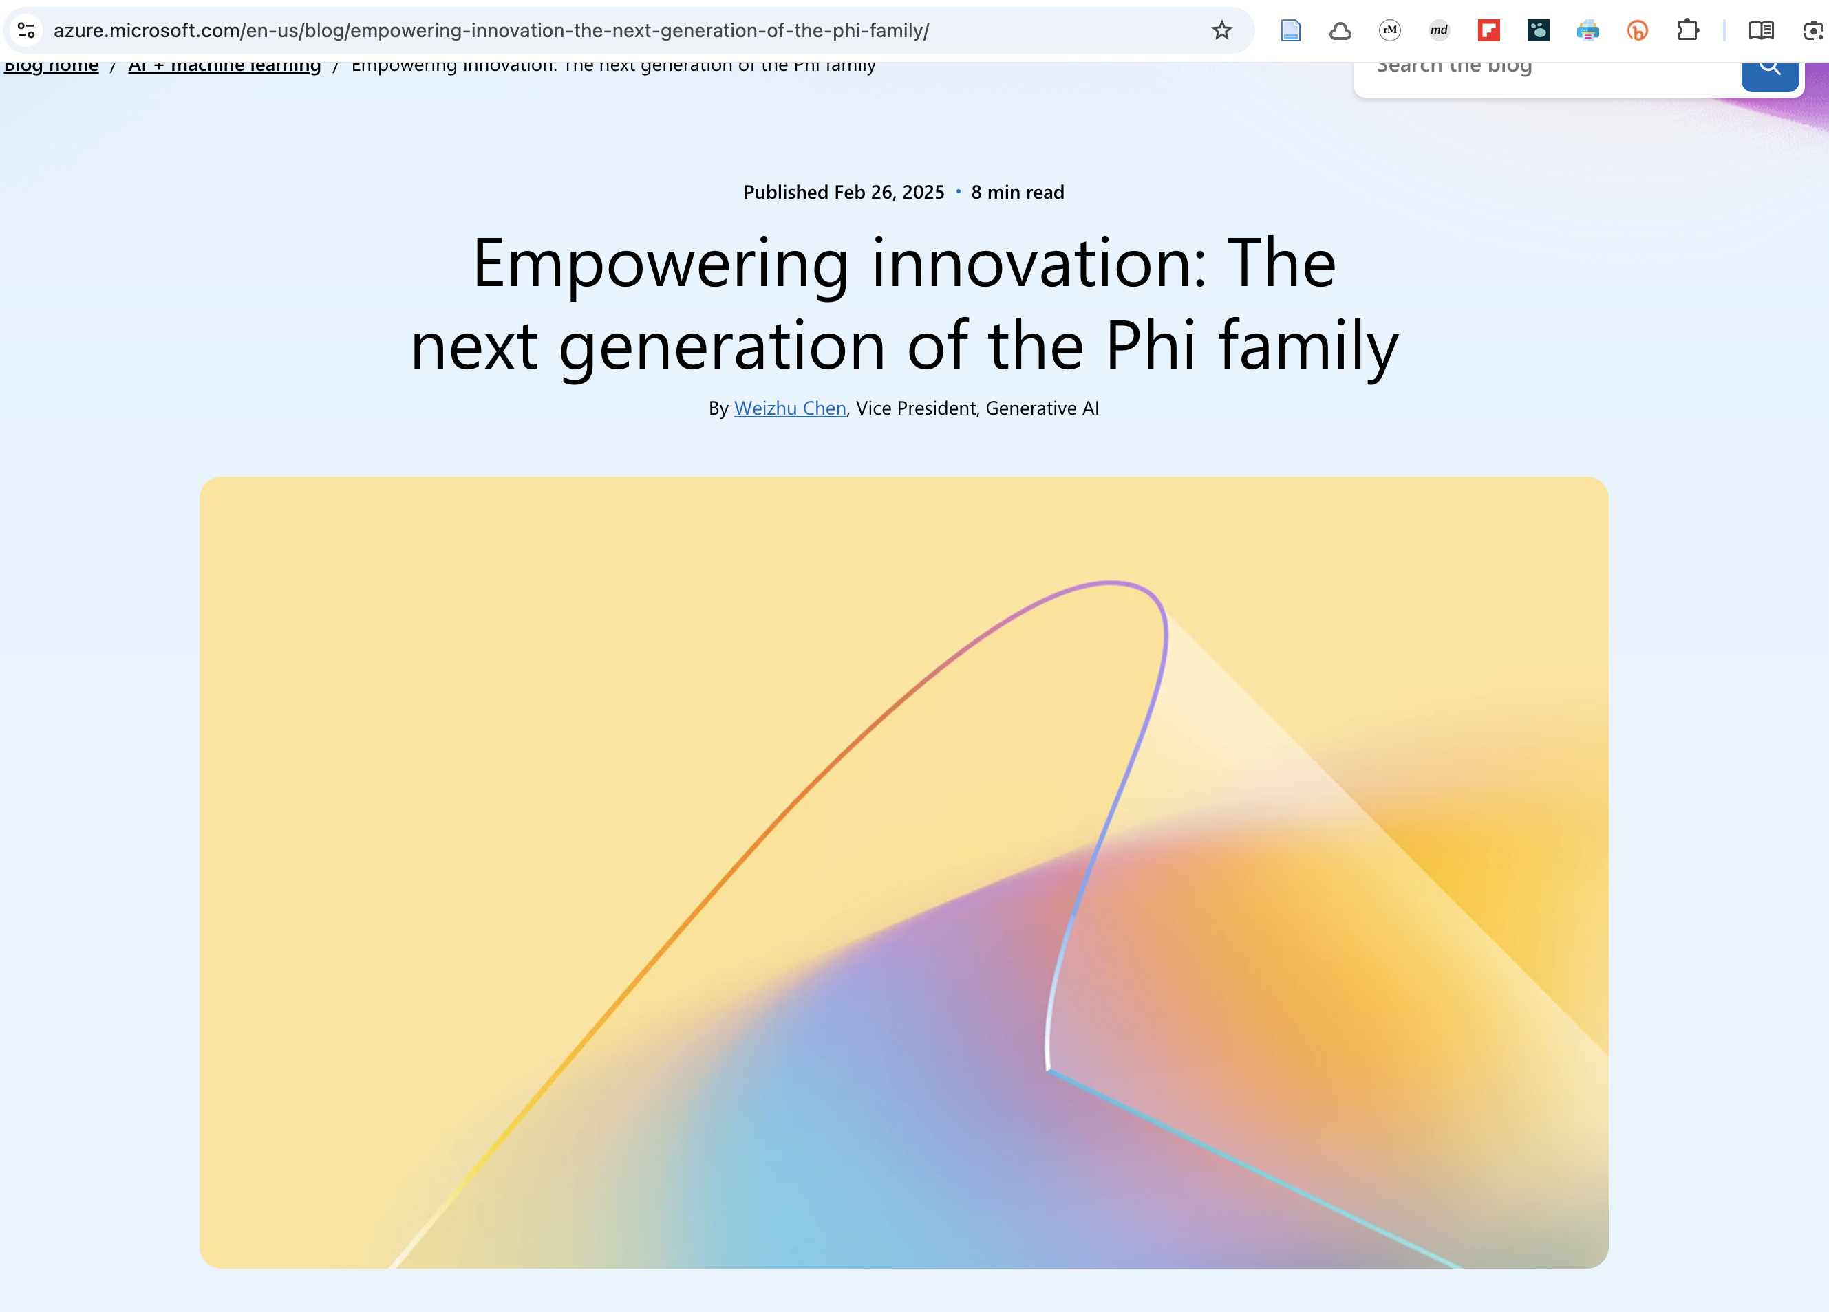

Slide 18
 | Small LM | Large LM
Size | Even <15m parameters | 7-500 B parameters
Hardware reqs | Edge devices | Many/Hundres GPUs
Task complexity | Simple, specific tasks | Complex tasks, multiple areas
Training | Days/weeks | Months
Small Lanaguage Models

